Slide 1
Developing Your Project Locally with VS Code

Slide 2
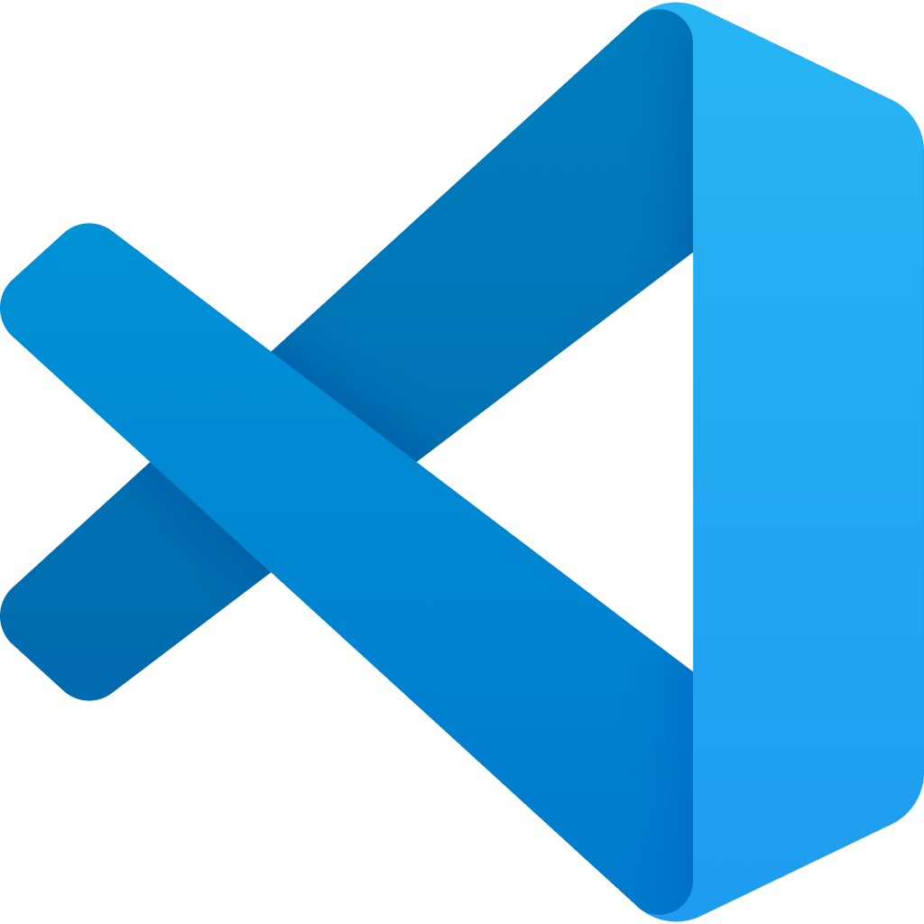
Visual Studio Code
Notes:
Visual Studio Code is a lightweight source code editor which runs on multiple platforms such as Mac, windows, and Linux.

Slide 3
Why running a development environment locally?
Notes:
Visual Studio Code is a lightweight source code editor which runs on multiple platforms such as Mac, windows, and Linux.

Slide 4
Codespaces
Notes:
Before we talk about running VS Code locally on your machine, let’s recap what happened when you’re writing codes on Codespaces.

Slide 5
Codespaces
Notes:
In the context of Codespaces, the VS Code editor is running on a Linux virtual machine managed by Microsoft remotely. Codespaces provides cloud-based development environments, and users generally work with these environments in a browser-based VS Code editor.

Slide 6
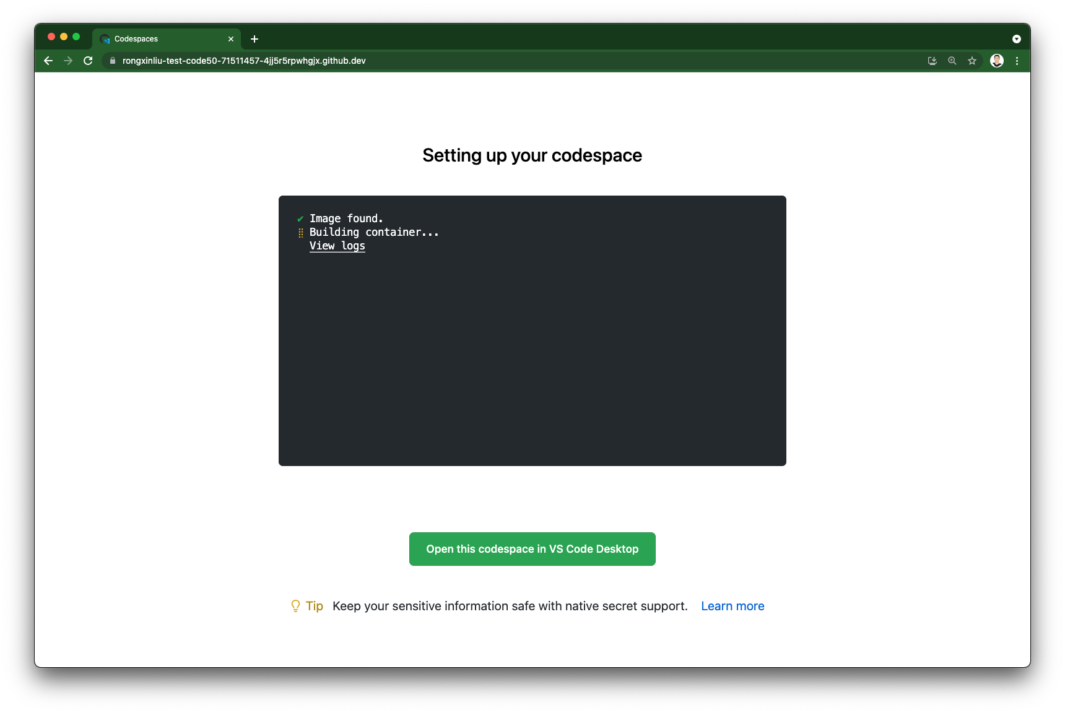
Notes:
Many of you are probably familiar with this page whenever you trying to open your Codespaces. What it is doing is that the remote Linux machine is launching and provisioning an environment for your Codespaces. It’s where all of the compute associated with software development happens: compiling, debugging, restoring, etc. At a high-level view, the Codespaces environment provided by CS50 comes with the software packages such as python, nodejs, sqlite, http-server, CS50 library that you would need to successfully complete your problem sets.

Slide 7
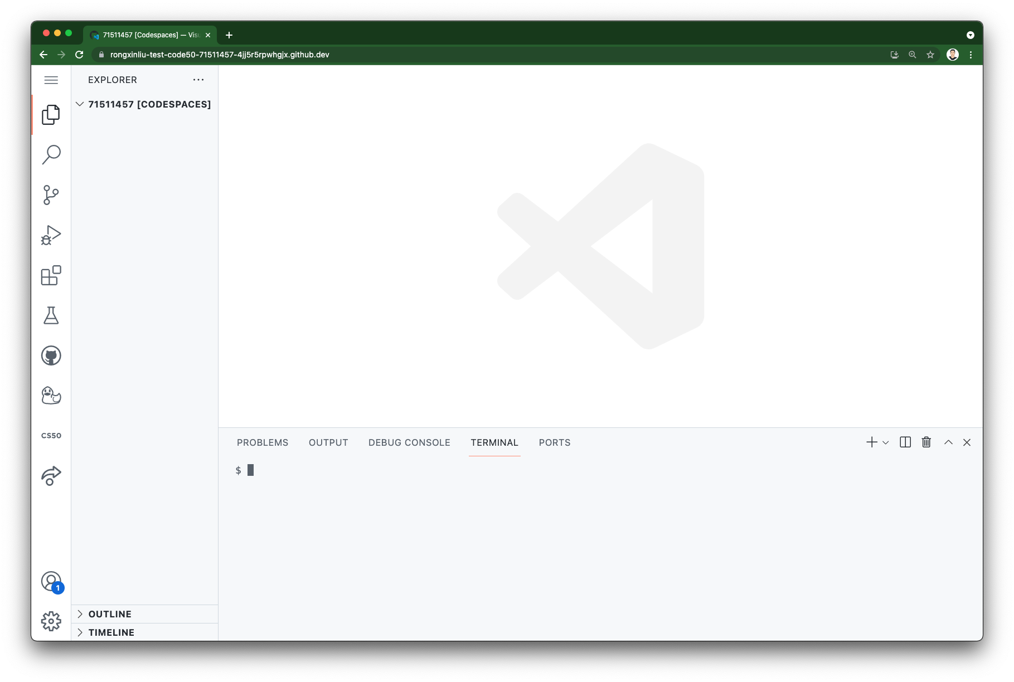
Notes:
Once you’re in, Codespaces automatically configures everything you need to work with your problem sets: runtime, compiler, debugger, editor, custom user settings, relevant editor extensions, and more. At a high-level view, the Codespaces environment provided by CS50 comes with the software packages such as python, sqlite, http-server, CS50 library that you would need to complete your problem sets successfully.

Slide 8
Environment:
Operating System: Linux (Ubuntu 20.04)
Pre-installed software packages:
Python 3
NodeJS
http-server
Flask
sqlite3
…
Codespaces

Slide 9
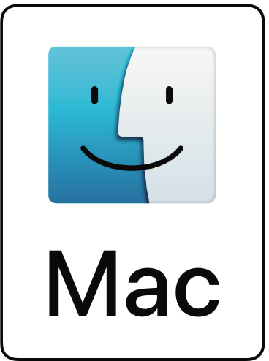

Slide 10
Environment:
Operating System: macOS
Pre-installed software packages:
Python 3 ?
NodeJS ?
http-server ?
Flask ?
sqlite3 ?
…

Slide 11
Visual Studio Code
https://code.visualstudio.com

Slide 12
Python 3
https://www.python.org/downloads/

Slide 13
NodeJS
https://nodejs.org/

Slide 14
http-server
https://www.npmjs.com/package/http-server

Slide 15
sqlite3
https://www.sqlite.org/download.html

Slide 16
CS50 Library
https://github.com/cs50/libcs50

Slide 17
Developing Your Project Locally with VS Code

